Slide 1
Canada’s C-Force in Hong Kong and its Forerunner -- from a social philately approach
©Sam Chiu Ph.D. 2021
FRPSL
FRPSC/VP
FIP Jury Fellow
Presented at RPSL 7 Jan 2021

Slide 2
Content
1 Brief Introduction
2 Postal history of C-Force in Hong Kong: I) Y-Force in Jamaica as forerunner, II) enroute to HK, III) arrival in HK, IV) detained mail, V) returned mail and VI) POW mail in HK/Japan.
3 Benton Correspondence WG
4 Dowling Correspondence RCCS
5 Lester Correspondence RRC

Slide 3
1 Brief introduction to Canada’s C-Force in Hong kong
Has been referred to as:
C-Force
Canadian Force C
Force C
Care Force C
Canadian Care Force C

Slide 4
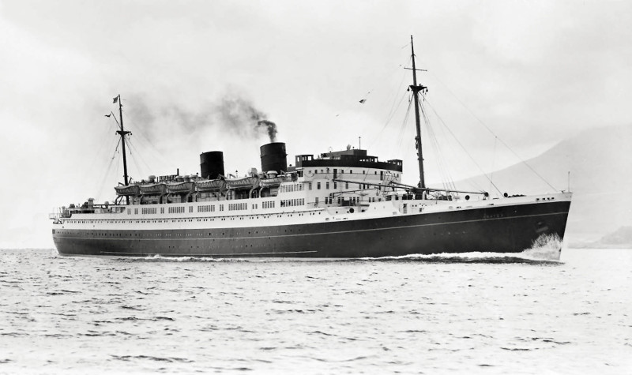
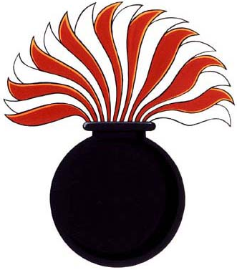
Transport to Hong Kong
Canada sent 2 battalions to help in the defense of Hong Kong (HK) just before the Japanese Invasion of HK on Dec 8th, 1941.
These were the Winnipeg Grenadiers (WG) and the Royal Rifles of Canada (RRC).
1,975 men of all ranks set sail on TSS Awatea and HMCS Prince Robert (150 men only) from Vancouver on Oct 27th, 1941 and made brief stops in Honolulu, Hawaii on Nov 2nd and Manila, Philippines on Nov 15th, reaching HK on Nov 16^{th.}
Insignia WG
TSS Awatea
Insignia RRC

Slide 5
Map of the Battle of Hong Kong First Strike on 1941 Dec 8th (from HKVCA website)
3-prong attack by Japanese Infantry regiments, 230th (west), 228th (center) and 229th (east) from the 38th division of the 23rd Army. Also with 38th Mountain Artillery regiment, the 38th Engineering regiment and attached were 2 more independent Mountain Artillery regiments. (From Canada At War website)

Slide 6
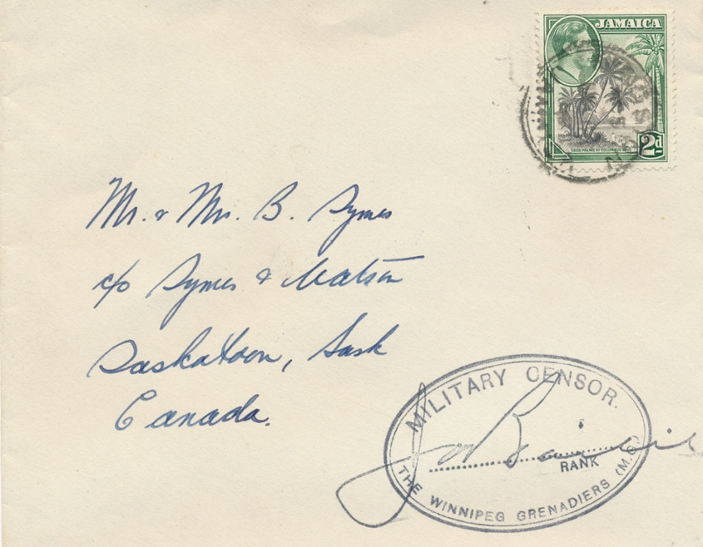
i) Forerunner (1): Y Force in Jamaica
2 postal history of C-Force in HK from a social Philately Approach
Y-Force in Jamaica as forerunner, enroute to HK, arrival in HK, detained mail, returned mail and POW mail HK/Japan.
Sent by a member of WG, from Kingston, Jamaica, 1940 Jul 9.
Early cover sent only 18 days after their arrival in Jamaica. Sender was not required to put his name on the cover. This would soon change. Censor’s signature cannot be deciphered.
Sent by Private Stanley Delbert Symes, H6928, C Company, WG, from Kingston, Jamaica, 1940 OC?
Censored by Major Kenneth George Baird, who was captured in Sham Shui Po, interned at North Point, Camp H and transferred to Sham Shui Po, Camp S, until liberation. He passed away in March 1990.

Slide 7
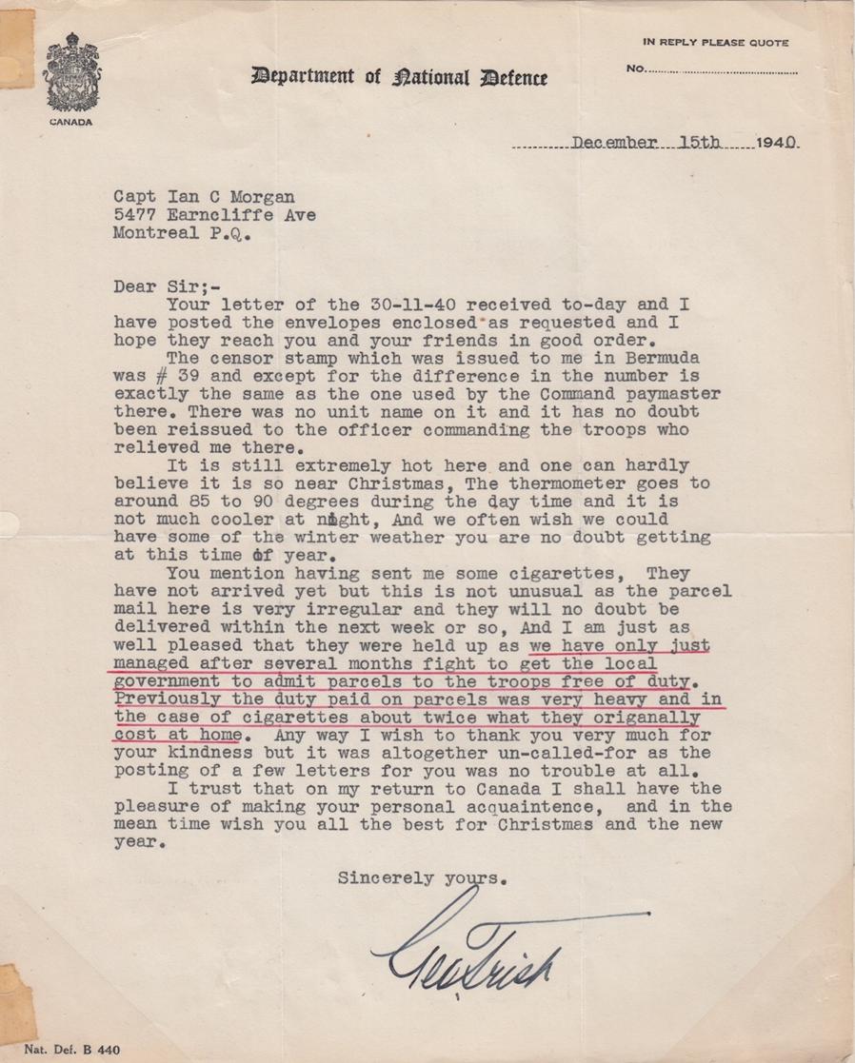
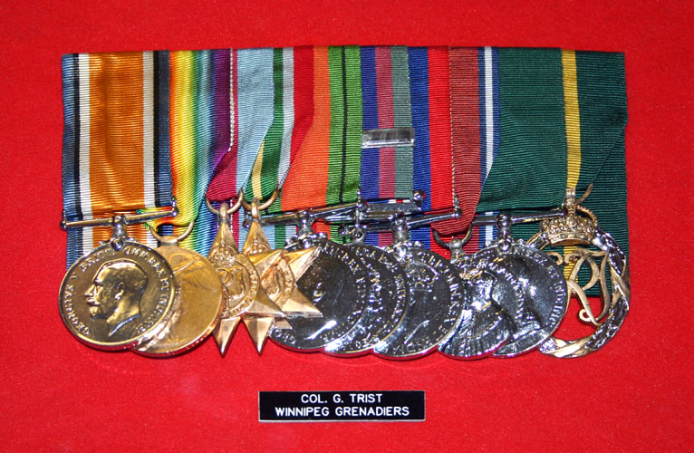
Forerunner (2): Y Force in Jamaica
Sent and self-censored by Major George Trist WG to Department of National Defence 1940 Dec 23rd (enclosure).
(HKVCA website)
In HK he was interned at all 3 camps that were recorded to have held Canadian POWs, i.e. North Point Camp H, Sham Shui Po Camp S and Argyle Camp N. He passed away in May 1997.
Major George Trist reported on the receipt of the censor stamp (marking) and also trouble with Jamaica Customs on duties on importing Cigarettes from home (underlined in red).

Slide 8
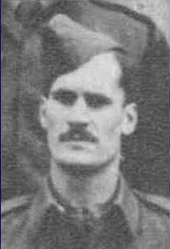
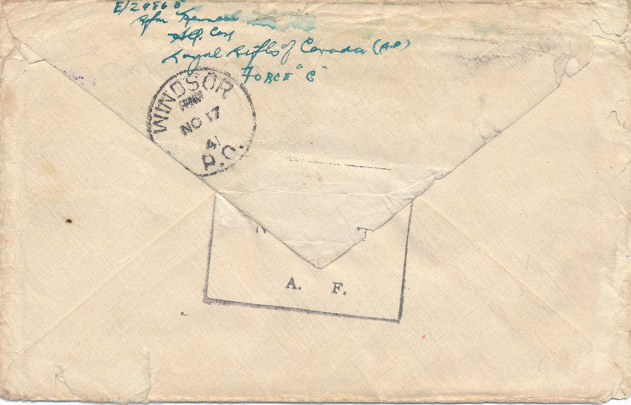
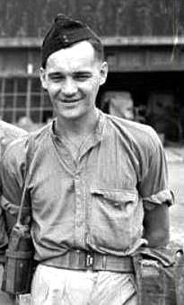
II) Mail on route at Honolulu Nov 2
Lt. MacDougall
Sent by Rifleman Kenneth Muir, E29868, RRC and Censored by Lieutenant Peter Lewis MacDougall.
Ken Ellison (Force C, The Canadian Army’s HK story, pg. 6) recorded an item with WG HQ markings on the same day from Honolulu, but not this marking for RRC

Slide 9
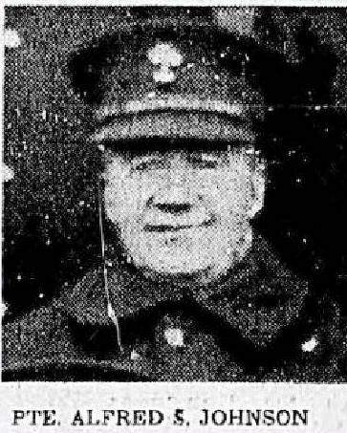
III) Arrival in HK (1)
Nov 28th, sent 12 days after arrival in HK. Censored by Major K.G. Baird WG. Written by Private Alfred Stanley Johnson WG at Battalion HQ company, who received a MiD (Mention-in-Dispatches) decoration.
Besides the 2 battalions sent, there was also an HQ company sent to HK.
Carried on the last surface transport leaving HK before the Japanese Invasion
(HKVCA website)
Number 137 triangular British army censor marking was assigned to WG, usually found in black ink or violet ink, but not in vermillion ink
(Richard Whittington confirms this is the only one in red ink he has recorded)

Slide 10
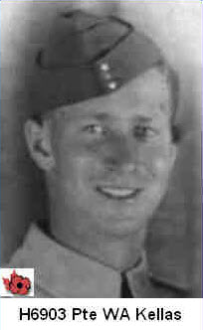
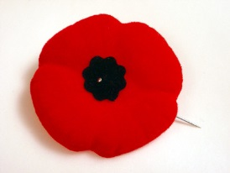
Arrival in HK (2)
Censored by Leonard B. Corrigan WG, Nov 28th. He was wounded in action Dec 24th, with MiD decoration.
Carried on the last surface transport leaving HK before Japanese Invasion
C.268 Censor Tape Ottawa
Lt. Corrigan
(HKVCA website)
Sent by Private William Alexander Kellas, H6903, D Company, WG. MIA Dec 21st, 2 days after Major Gresham and Master Sergeant Osborne VC was killed. He was last seen around Jardine’s Lookout. Arrival CDS Bury, Quebec 1942 Jan 10th. 2 weeks after the capitulation of HK

Slide 11
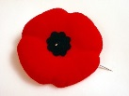
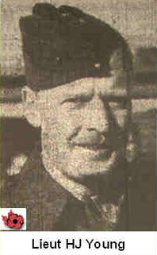
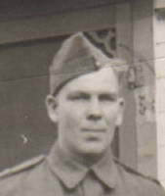
iv) Detained in HK (1) From Dec 1941 to Sept 1945
Dec 7th 10:30 AM, Censored by Lieutenant Hugh James Young, B-Company, 12th Platoon Commander, KIA on Dec 21, 1941. Sent by Private George Ernest Smith, H6910, B-Company, WG. As POW in Sept. 1943 was sent to Japan to work at a nickel mine and refinery. He passed away in January 1966.
(HKVCA website)
Detained covers with arrival markings after the war are scarce.
This with Plumas, Manitoba CDS, Oct 6th, 1945

Slide 12
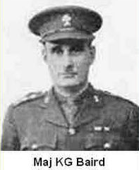
Detained in HK (2) From Dec 1941 to Sept 1945
Dec 7th, 11 AM. Self- censored by Major K.G. Baird WG,
second highest ranking officer recorded as a censor
(HKVCA website)

Slide 13
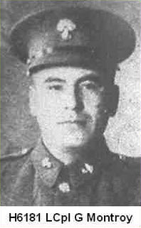
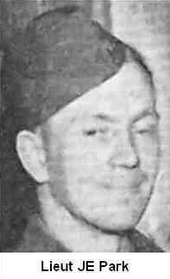
Detained in HK (3) From Dec 1941 to Sept 1945
Dec 8th at 12:30 PM, invasion already started at 8 AM.
Censored by Second Lieutenant John Elphinstone Park, B-Company, Platoon Commander. Sent by Lance Corporal George Montroy, H6181, C-Company, WG. Wounded in Action Xmas Day. As POW, in Sept. 1943 was sent to Japan to work in a nickel mine and refinery. He passed away in October 1987.
(HKVCA website)
1 of 7 cover recorded with 2 strikes of Detained markings on same cover

Slide 14
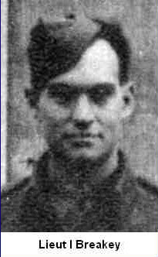
V) Undeliverable mail from Canada TO HK
Sent on 1941 Oct 31 from Quebec City,
returned on Apr 7th 1942
Shows that most, if not all, C-Force members did not receive any mail from relatives after they departed Canada on Oct 27th
Addressed to Lieutenant Ian Breakey, D-Company, 16th Platoon Commander. He passed away in September 1998. He was 1 of 22 Lieutenants of RRC.
(HKVCA website)
Ken Ellison (pg. 17) had a cover from same correspondence sent Oct 7th and returned to sender on 1942 Mar 17th.

Slide 15
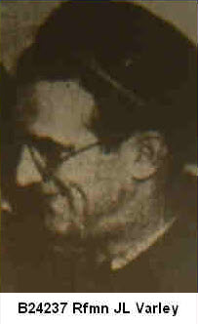
vi) Mail to POW in HK
(Left) May 5th and (right) May 15th 1942 covers addressed to Corporal (promoted from private) John Leslie Varley, B24237, RRC. Wounded in action on Dec 25th, 1941. He was awarded the Military Medal (MM).
C.208 Censor Tape Ottawa
C.203 Censor Tape Ottawa
The large red “S” marked denotes Camp S, Sham Shui Po Camp, where about 7000 British Army & Navy were held with 100 US servicemen. Canadian POWs were moved to this camp from Sept 1942 and many were interned there until liberation. The blue box is “HK POW camp censor” marking and the small oval “chop” is the family name of the censor. Both censored by Niimori 新森 .
(HKVCA website)

Slide 16
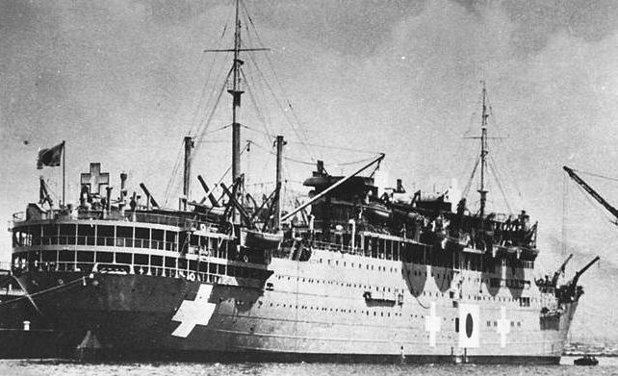
How were these letters most likely transferred from/to HK?
2 exchanges were made, both carrying mail and civilian detainees from both sides
Gripsholm and Tiea Maru in Mormugoa, Goa for the second exchange in 1943
(from WW2christianfiction.com)
Gripsholm
Tiea Maru

Slide 17
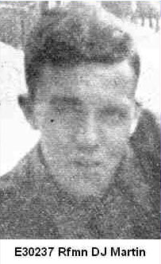
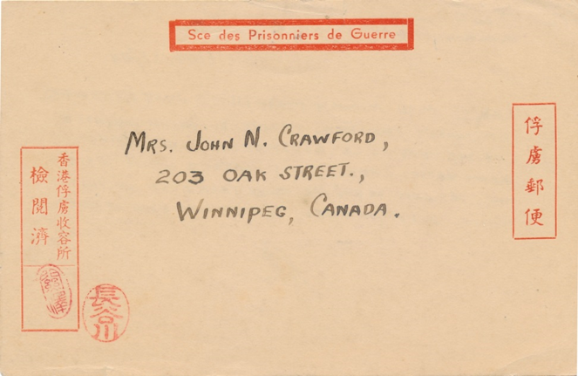
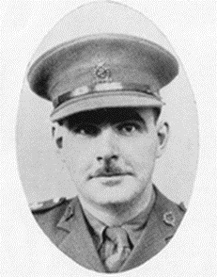
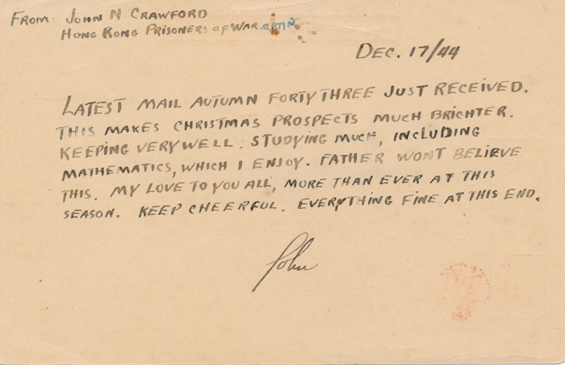
Mail From POW in HK
Sent by Major John Neilson Brown CRAWFORD, dateline 1944 Dec 17th. A member of the Royal Canadian Army Medical Corps, he was appointed to HKVDC ambulance reporting to Brigade HQ and assigned to WG. He headed the medical facility while as a POW. He was awarded the MBE. He passed away in June 1997.
Sent by Rifleman Douglas John Martin, E39302, D Company, 18th Platoon, RR, recorded as wounded-in-action. He was interned in HK until repatriation. He passed away in October 1998.
(HKVCA website)
DB/650 Censor Tape Ottawa
The use of a POW imprinted envelope, rather than a POW imprinted postcard, is very rare. The British censor label on the left is covering the Japanese censor marking below.
The Japanese had Crawford made a recording on POW life in HK in November 1942. This was broadcast over Radio Tokyo. About 15 people in the Western States picked it up on short wave. They eventually relayed the message to Crawford’s wife. (Ellison , Force C , pg. 85)

Slide 18
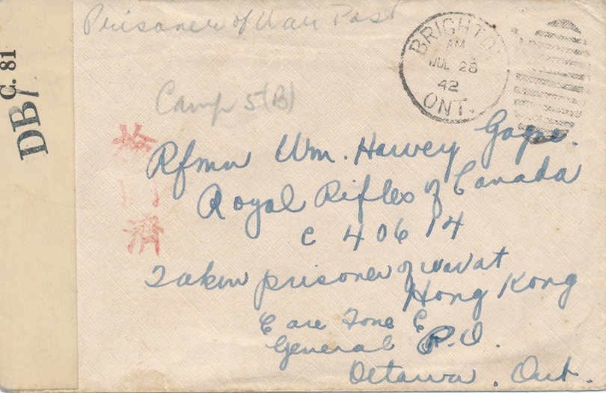
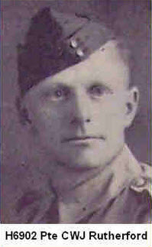
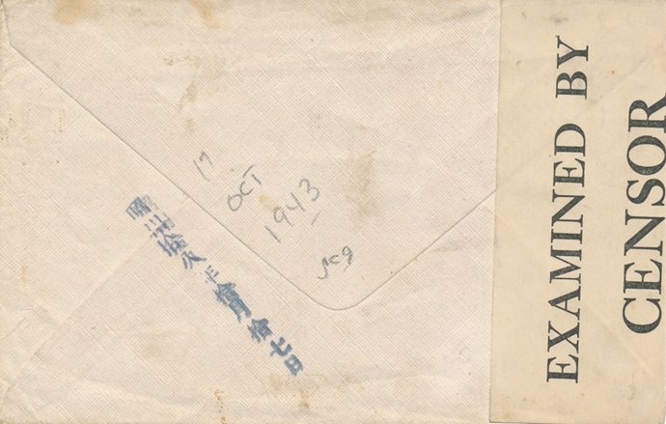
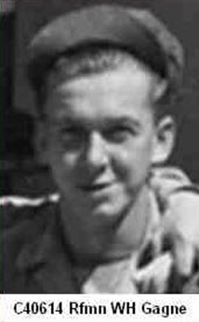
Mail to POW in HK/Japan
Sent from Winnipeg 1942 Mar 22nd with Ottawa transit May 25th, addressed to Private Campbell William John Rutherford, H6902, D Company, WG. He passed away in September 1989.
Sent from Brighton, ON 1942 July 28th, addressed to Rifleman William Harvey Gagne, C40614, RR. He was moved to Japan in Sept 1943 to Port of Niigata as a labourer moving foodstuff, mining coal in Rinko and as a labourer at a foundry in Shintesta, until liberation. He passed away in June 1996.
(HKVCA website)
Barely visible is: Received 1943 March 20th in blue pencil on back. Rare to record a notation of arrival date on POW mail.
The date stamp is Showa 18th year (1943) Oct 17th. Rare to record an arrival date on POW mail. Very rare if it was a marking.

